Slide 1
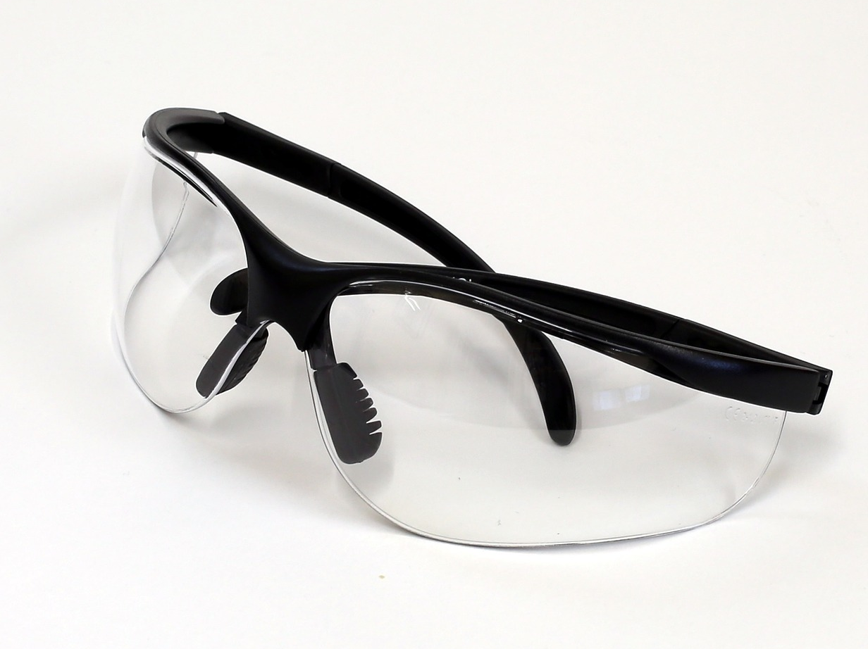
A guide to…
Choosing Eye & Face Protection

Slide 2
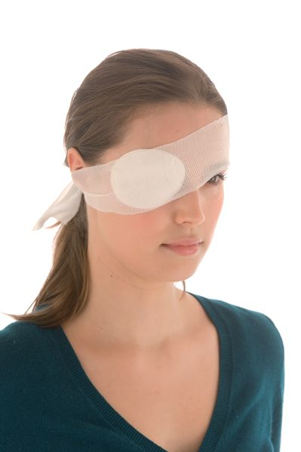
Introduction
Eye injuries can result in pain, loss of time, money and eye sight. Many daily tasks cause flying debris which can seriously injure your eyes.
If you cause injury to your eyes, it can have serious and long lasting affects or even cause permanent damage.
Using the correct eye protection for the task can prevent most eye injuries.

Slide 3
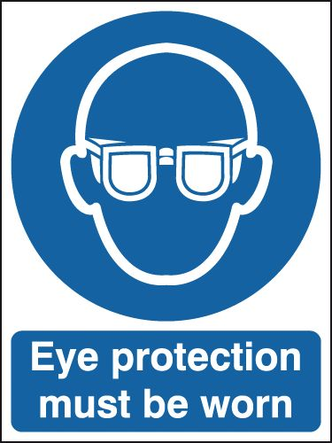
Legislation
Regulation 4 of the Personal Protective Equipment at Work Regulations 1992 states:
Every employer shall ensure that suitable personal protective equipment is provided to his employees who may be exposed to a risk to their health or safety while at work except where and to the extent that such risk has been adequately controlled by other means which are equally or more effective.
Employees also have a duty under Section 7 of the Health and Safety at Work Act to ensure their own health and safety at work. Refusing to wear necessary equipment to control exposure to risks puts them in breach of that duty and of the Regulations.

Slide 4
Hazards to Eyes
Some of the most common hazards to eyes include:
Chemical or metal splashes
Dust particles
Projectiles
Gas and vapour
Radiation
Additional considerations:
Windy or dusty conditions can lead to particles in the eye
Eye injuries can result from co-workers around you
Passing through an area where work is being carried out can generate a hazard

Slide 5
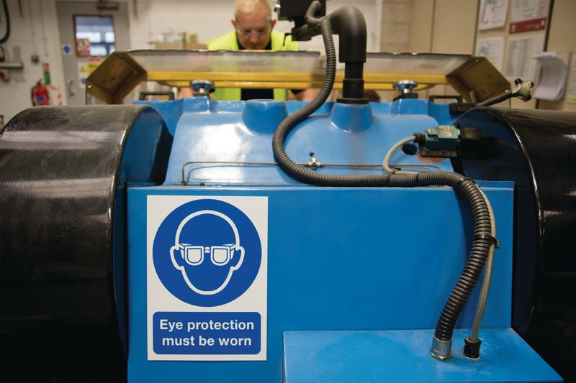
Risk Assessment
Employers must complete a risk assessment to decide whether PPE is required and will be suitable for the task.
This includes deciding on the risks to be combated, the working conditions and the part(s) of the body to be protected.
Employers must provide personal protective equipment (PPE) that offers suitable protection to personnel who may be exposed to potential health risks.
When a risk assessment has been completed and employers decide that PPE is required to safeguard against a risk, employees MUST wear it and employers MUST enforce its use.

Slide 6
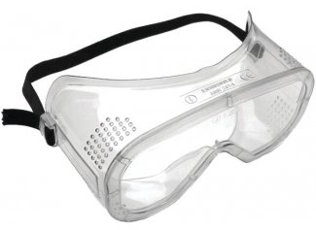
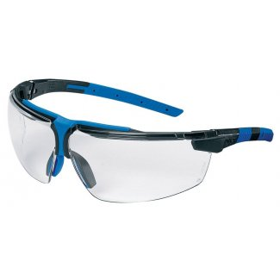
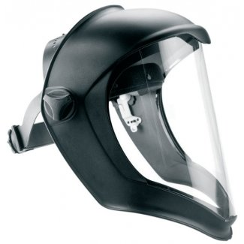
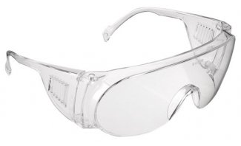
There are four main types of eye protection available…
Safety Glasses or Spectacles
Safety Goggles
Eye Shields
Face Shields

Slide 7
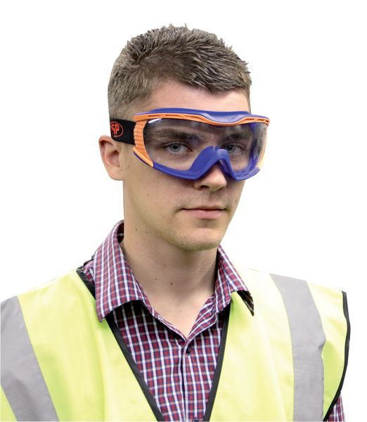
Selecting Suitable Eye/Face Protection
The selection of suitable eye protection depends primarily on the hazard, but comfort and durability should also be considered.
The wearer(s) of eye protection should be consulted and involved in the selection process.

Slide 8
Safety Glasses or Spectacles
Safety glasses or spectacles provide protection against impact from small objects.
Available in a variety of styles, weights and sizes.
Many manufacturers offer a range of prescription safety spectacles which are individually matched to the wearer.
Different levels of impact resistance are available.
Similar to prescription glasses, however they have side shields that provide lateral protection.
Suitable for general working conditions where there may be minor dust, chips or flying particles.
Provide little or no protection against liquids or vapours.

Slide 9
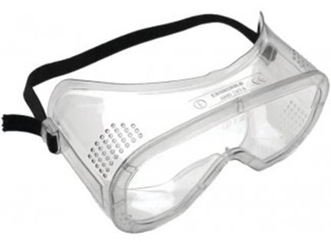
Safety Goggles
Safety Goggles are heavier and less comfortable than glasses but provide much better protection.
More prone to misting and should be treated with anti-mist coatings.
Ideal when the eyes need to be completely covered but the rest of the face does not need to be protected.
Different types of goggles are available to provide protection from liquids, dusts, gases, vapours, molten metal and high impact projectiles.
Goggles can also be obtained with a range of filters to provide protection against lasers and welding flash.

Slide 10
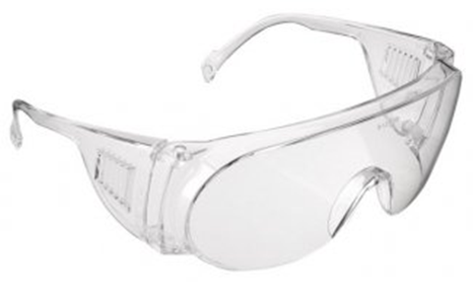
Eye Shields
Eye shields are similar to safety glasses, however they have a single frameless one-piece lens.
These provide a similar level of protection to safety glasses.
Eye shields can be useful for visitors and other people who need eye protection only for short periods.
Some styles can be worn over prescription glasses.

Slide 11
Face Shields
Face shields protect the face but do not fully enclose the eyes.
Provide protection against impact, spraying, chipping, grinding or chemical splashes.
Frequently used in conjunction with eye protection, as they are not by themselves protective eyewear.
The heaviest and bulkiest form of protection. However, they should be comfortable if they are fitted with an adjustable head harness.
They can include welding filters or reflective metal screens that deflect heat.

Slide 12
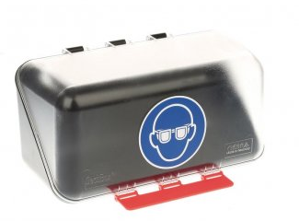
Eye/Face Protection Storage
All eye protectors need to be properly cared for and stored.
Personal issue eyewear should be stored in a suitable spectacle case or eyewear container when not in use.
Those for visitors should also be suitably stored, e.g. in a purpose made “store-and-issue” wall mounted container.

Slide 13
Cleaning Eye/Face Protection
The lenses of eye protectors must be kept clean; dirty lenses can restrict vision and cause eye fatigue, which can lead to accidents.
If eye shields or other eye protection for visitors are provided, they should be thoroughly cleaned before they are reissued.

Slide 14
Eye/Face Protection Maintenance
All eye protectors need to be properly cared for and stored.
If you notice any defects or damage, or if you have lost/misplaced your eye protection, you should inform your supervisor straight away.
Transparent visors and face shields should be changed if they are scratched or cracked, warped, or have become discoloured or brittle with age.
Headbands should be replaced when they are damaged or worn out.

Slide 15
Do’s and Don'ts
Do wear eye protection whenever it’s required.
Do make sure your eye protection fits comfortably and does not hinder your view.
Do look after your eye protection and return it to a suitable container after use.
Do report any defects, damage or loss to your supervisor.
Do keep it clean .
Don’t use prescription glasses or sunglasses as eye protection.
Don’t ignore instructions to wear eye protection.
Don’t just walk past someone not wearing eye protection when they should – tell them to put it on!
Do not modify eye protection by removing the side shields.

Slide 16
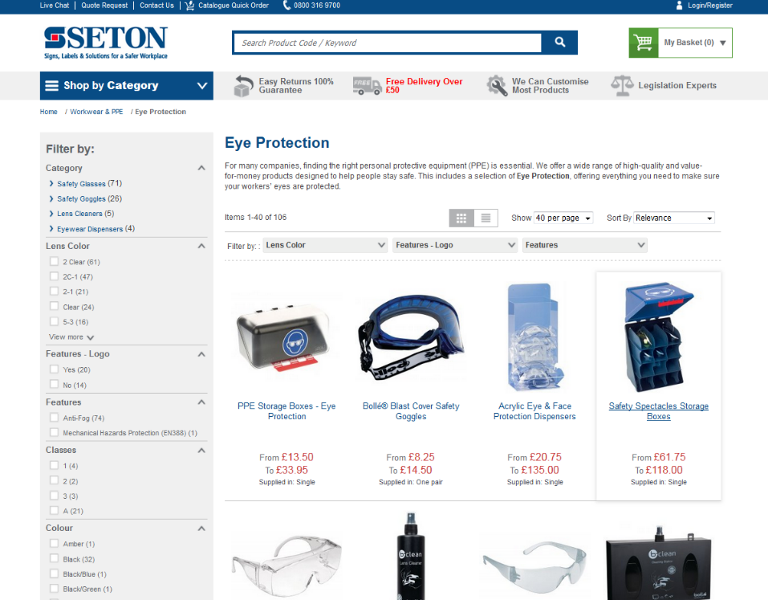
Product Solutions
When it comes to safety in the workplace, quality products are key.
For a full, comprehensive range of Eye and Face Protection products, simply go to
seton.co.uk
Over 52,000 quality products
Same day despatch on stock items
£500 instant credit
No quibble, easy returns policy
Dedicated Quotations Team for bulk orders and hard-to-find items
100% satisfaction guarantee

