Slide 1
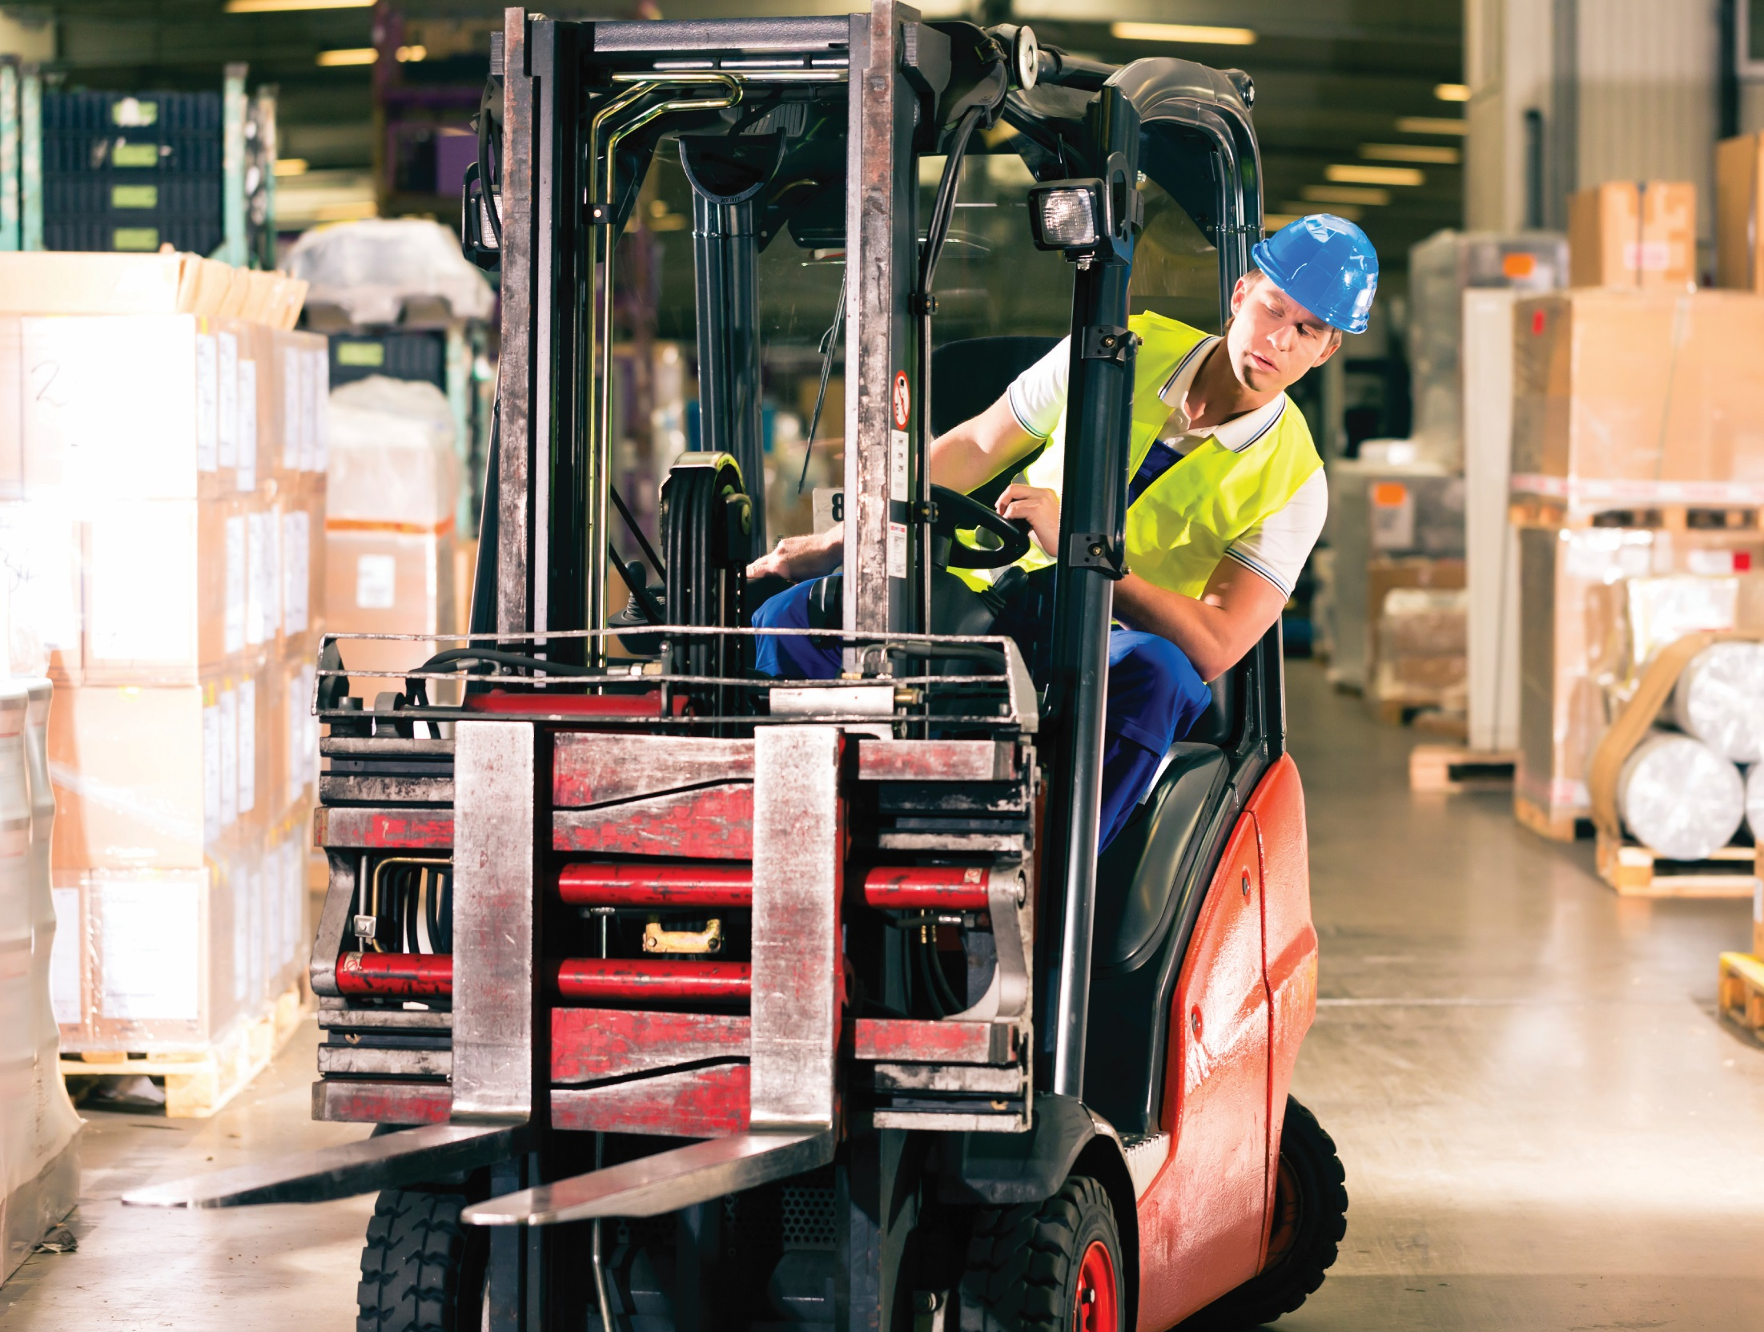
Warehouse & Storage Safety

Slide 2
Overview
Legislation:
The Management of Health and Safety at Work Regulations 1999
The Workplace (Health, Safety and Welfare) Regulations 1992
The Work at Height Regulations 2005
The Manual Handling Operations Regulations 1992
There are many hazards in the warehouse, including:
Slips and trips
Manual handling
Work at height
Vehicles in and around the workplace
Moving or falling objects

Slide 3
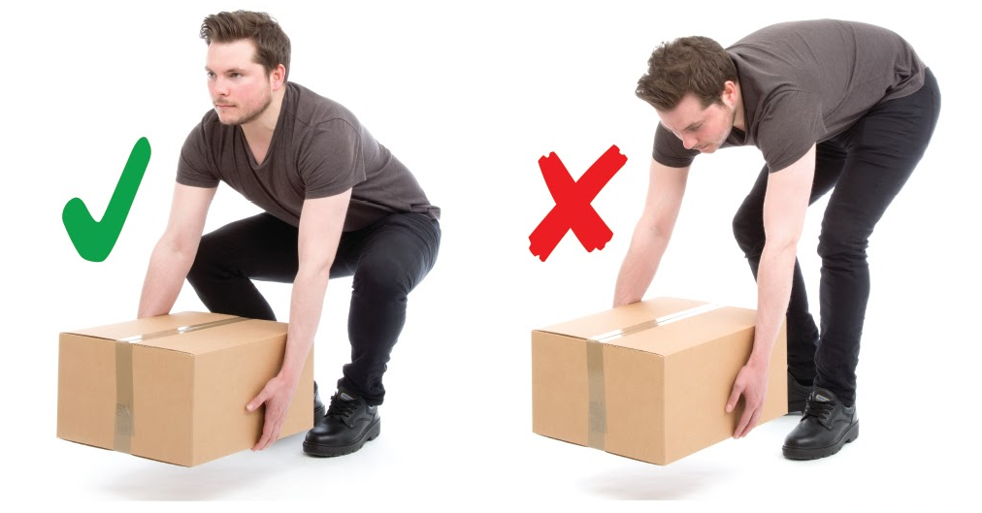
Manual Handling
Much warehouse work entails a risk of back injury and muscular strains from lifting and moving heavy or bulky items of stock. Consequently, taking steps to prevent such injuries should be a major part of health and safety procedures.
Steps include:
Using mechanical devices where possible, such as trolleys, pallet movers, conveyors and scissor lifts.
This equipment should be regularly maintained and inspected and the operators fully trained.
Breaking up loads to make them more manageable.
Using two or more people for certain jobs.
Ensuring aisles are of sufficient width and are clear.
Raising the height of working platforms to reduce the need to bend or twist.

Slide 4
Vehicles
Vehicle movement in and around warehouses requires careful and constant management to prevent accidents.
Where vehicles and pedestrians use the same traffic route, there should be adequate separation between them and, if possible, complete separation of vehicles and pedestrians.
Steps that need to be taken include:
Ensuring the vehicles being used are safe and have been properly maintained.
Ensuring the driver is safe and has had appropriate training.
Minimising the need for reversing.
Avoiding sharp bends and blind corners.
Maintenance – not allowing potholes and uneven surfaces to develop.
Taking into account features that can affect load stability, such as steep slopes.
If possible, the need for reversing should be eliminated or, if this is not possible, minimised. Pedestrians should be kept out of areas where vehicles reverse.

Slide 5
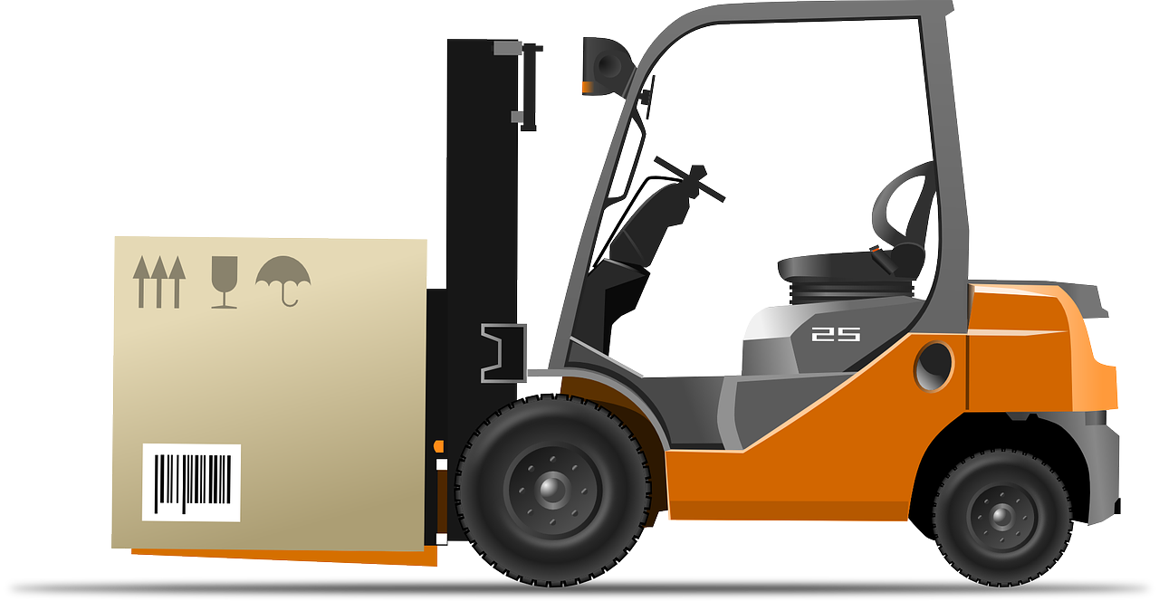
Forklift Trucks
The safe use of forklift trucks requires:
Drivers to have received adequate training.
Inspection and maintenance to ensure the trucks are in a safe condition.
Safe operating procedures, including arrangements to prevent overloading and prohibiting riding on the forks.
Keys to the forklift are always removed by the operator at the end of his/her shift and kept in a safe and secure place to prevent unauthorised use of the vehicle.

Slide 6
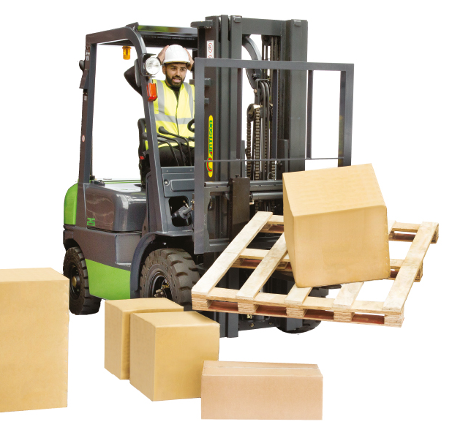
Moving and Falling Objects
Many injuries to employees in the warehousing and storage are caused by being hit by falling or moving objects.
The risk from falling objects is elevated in high ceilinged warehouses.
Items can fall from racking that is badly designed, maintained or used, from persons working at height or from cranes, elevated platforms or forklift trucks.
Areas and specific activities in the warehouse where there is a risk of an object falling and striking someone should be clearly indicated to prevent entry by unauthorised persons.
Racking should be designed, maintained and used to prevent it being overloaded and to prevent the racking itself from toppling.
Materials should be stacked securely to prevent them falling and injuring staff below.

Slide 7
Slips and Trips
Factors that contribute to slip and trip accidents in warehouses include:
Unsuitable floor surfaces
Wet or contaminated floors
Unsuitable footwear
Poor lighting
Obstructions in walkways
Uneven surfaces
Steps must be taken to ensure the following:
There is good housekeeping to ensure passageways are kept clear of clutter, obstacles and other trip hazards.
Passageways are clear of potholes and uneven surfaces, inspected regularly and properly maintained.
Cables are fastened securely to floor or re-routed overhead.
Spillages are cleaned up immediately and warning notices displayed.
The floor is suitable for the type of work carried out.
Visibility is not adversely affected by poor lighting.
.

Slide 8
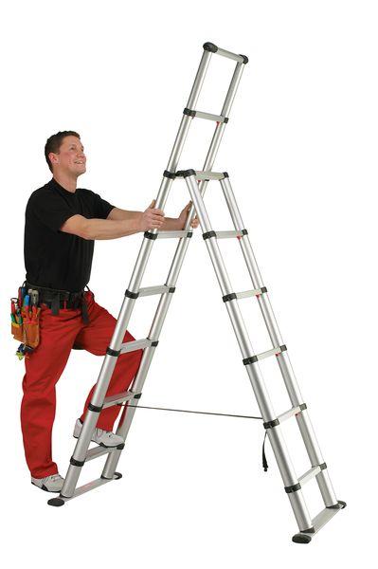
Work at Height
It is not unusual for warehouse workers to work above floor level, for instance:
Stacking goods on high shelving
Removing goods from high places
Using ladders or mechanical pickers
Walking on elevated walkways or flooring
If possible, work at height should be avoided. If working at height is necessary, equipment that prevents falls from height should be used.
If the risk cannot be completely eliminated, equipment should be provided that minimises the distance if the person is at risk from falling, and reduces the risk of serious injury.
Employees should be properly trained for working at height.

Slide 9
Seton have all the equipment you need to keep your employees safe in the warehouse environment
Visit us online at
seton.co.uk

